Slide 1
MNIST:
An introductory example using NNX
Build and train a simple CNN with NNX
Notes:
Now that you’ve learned the basic concepts of the JAX AI Stack, let’s work through everybody’s favorite ML example - MNIST - to deepen your understanding. We will of course be training a simple CNN with NNX.

Slide 2
Download the MNIST dataset
#!wget -nc https://huggingface.co/datasets/ylecun/mnist/resolve/main/mnist/train-00000-of-00001.parquet
#!wget -nc https://huggingface.co/datasets/ylecun/mnist/resolve/main/mnist/test-00000-of-00001.parquet
import pandas as pd
train_file_path = '/content/train-00000-of-00001.parquet'
test_file_path = '/content/test-00000-of-00001.parquet'
mnist_train_df = pd.read_parquet(train_file_path)
mnist_test_df = pd.read_parquet(test_file_path)
Notes:
First, we download the MNIST dataset from Hugging Face. The dataset is stored in Parquet format, so we read it in using Pandas. We use wget commands to download the train and test dataset files. These are commented out, but we include them here so you can see how to download the files if needed.
Next, we import the Pandas library, which we will use for reading the Parquet files. We then define the file paths for the training and testing data. Finally, we use pd.read_parquet to read these files into Pandas DataFrames, named mnist_train_df and mnist_test_df.

Slide 3
Get the datasets ready
class Dataset:
def __init__(self, df):
self.df = df
def __len__(self):
return len(self.df)
def __getitem__(self, index):
return convert_to_numpy(self.df.iloc[index])
def convert_to_numpy(data_dict):
png_bytes = data_dict['image']['bytes']
image = Image.open(io.BytesIO(png_bytes))
image_array = np.array(image, dtype=np.float32) / 255.0
label_array = np.array(data_dict['label'])
return {'image':image_array[:,:,np.newaxis], 'label':label_array}
Notes:
We’re going to use Grain, the JAX-native loader to load the dataset.
We define a Dataset class that takes a Pandas DataFrame as input. Inside the class, the __len__ method returns the number of items in the DataFrame, and the __getitem__ method fetches an item at a given index and converts it to a NumPy array.
We also have a helper function called convert_to_numpy. This function takes a data dictionary, extracts the image bytes, and then uses the Python Imaging Library (PIL) to open the image. The image is then converted into a NumPy array, normalized by dividing by 255, and reshaped to add a channel dimension. Finally, it also extracts the label and returns both the image array and label array as a dictionary.

Slide 4
Create the Grain dataloaders
mnist_train = Dataset(mnist_train_df)
mnist_test = Dataset(mnist_test_df)
sampler = grain.SequentialSampler(
num_records=len(mnist_train),
shard_options=grain.NoSharding())
train_dl = grain.DataLoader(
data_source=mnist_train,
sampler=sampler,
operations=[grain.Batch(batch_size=batch_size, drop_remainder=True)]
)
test_dl = grain.DataLoader(
data_source=mnist_test,
sampler=sampler,
operations=[grain.Batch(batch_size=batch_size, drop_remainder=True)]
)
Notes:
Now, let's instantiate our Dataset class with the training and test DataFrames we loaded earlier. We'll create mnist_train and mnist_test objects. Next, we create a sequential sampler using grain.SequentialSampler. This sampler ensures that we iterate through the dataset in order.
Finally, we create DataLoader objects using grain.DataLoader. For both the training and test sets, we pass the respective Dataset object, the sampler, and specify an operation to batch the data. We use grain.Batch with our batch_size and drop_remainder=True to create batches and drop any incomplete batches at the end. This sets up our data loaders to provide batches of data for training and evaluation.

Slide 5
Define a CNN
class CNN(nnx.Module):
"""A simple CNN model."""
def __init__(self, *, rngs: nnx.Rngs):
self.conv1 = nnx.Conv(1, 32, kernel_size=(3, 3), rngs=rngs)
self.conv2 = nnx.Conv(32, 64, kernel_size=(3, 3), rngs=rngs)
self.avg_pool = partial(nnx.avg_pool, window_shape=(2, 2), strides=(2, 2))
self.linear1 = nnx.Linear(3136, 256, rngs=rngs)
self.linear2 = nnx.Linear(256, 10, rngs=rngs)
def __call__(self, x):
x = self.avg_pool(nnx.relu(self.conv1(x)))
x = self.avg_pool(nnx.relu(self.conv2(x)))
x = x.reshape(x.shape[0], -1) # flatten
x = nnx.relu(self.linear1(x))
x = self.linear2(x)
return x
Notes:
So far we’ve only done normal NumPy and Pandas stuff, and set up Grain. Now we can define our CNN model using NNX. The model consists of two convolutional layers, each followed by average pooling and ReLU activation. The output is then flattened and passed through two linear layers. This is a simple CNN architecture designed for classifying the MNIST digits.

Slide 6
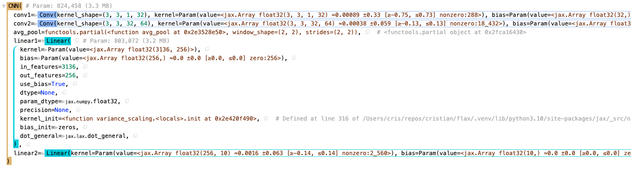
Display the CNN
# Instantiate the model.
model = CNN(rngs=nnx.Rngs(0))
# Visualize it.
nnx.display(model)
Notes:
We instantiate our CNN model and then use the nnx.display function to visualize its structure. This can be very useful for debugging and understanding the model's architecture.

Slide 7
Test run the CNN
import jax.numpy as jnp # JAX NumPy
y = model(jnp.ones((1, 28, 28, 1)))
# Array([[-0.06820839, -0.14743432, 0.00265857, -0.2173656 , 0.16673787,
# -0.00923921, -0.06636689, 0.28341877, 0.33754364, -0.20142877]],
# dtype=float32)
Notes:
To quickly test our model, we import JAX NumPy and pass a dummy input of ones to the model. This checks if the model runs without errors and produces an output. The output shown is an example of what one might expect.

Slide 8
Define optimizer and metrics
import optax
learning_rate = 0.005
momentum = 0.9
optimizer = nnx.Optimizer(model, optax.adamw(learning_rate, momentum), wrt=nnx.Param)
metrics = nnx.MultiMetric(
accuracy=nnx.metrics.Accuracy(),
loss=nnx.metrics.Average('loss'),
)
Notes:
Next, we define the optimizer and metrics. We use the AdamW optimizer from Optax. Notice the new wrt=nnx.Param argument in the nnx.Optimizer call. This is a key update in the latest version of NNX. It explicitly tells the optimizer that it should only apply updates with respect to variables of type nnx.Param. This makes the optimizer's intent crystal clear: it will update our learnable weights and biases, but correctly ignore other types of state.

Slide 9
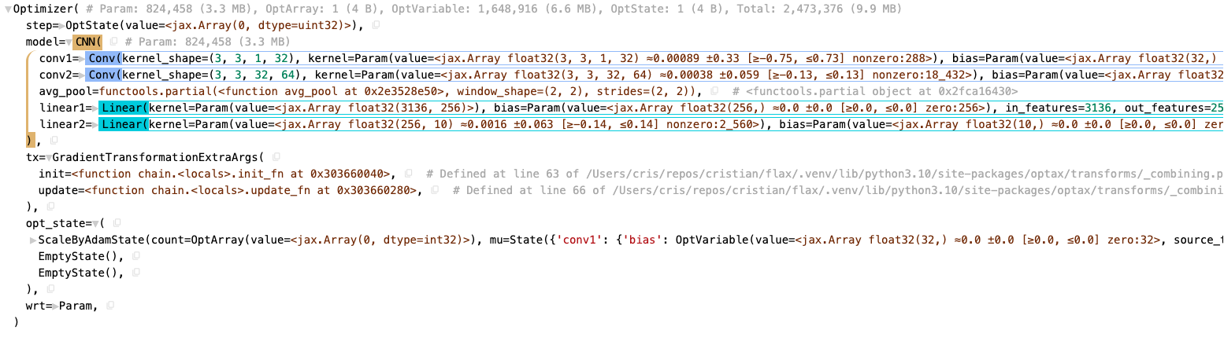
Define optimizer and metrics
nnx.display(optimizer)
Notes:
Similar to the model, we use nnx.display to visualize the optimizer setup.

Slide 10
Define training step functions
def loss_fn(model: CNN, batch):
logits = model(batch['image'])
loss = optax.softmax_cross_entropy_with_integer_labels(
logits=logits, labels=batch['label']
).mean()
return loss, logits
@nnx.jit
def train_step(model: CNN, optimizer: nnx.Optimizer, metrics: nnx.MultiMetric, batch):
"""Train for a single step."""
grad_fn = nnx.value_and_grad(loss_fn, has_aux=True)
(loss, logits), grads = grad_fn(model, batch)
metrics.update(loss=loss, logits=logits, labels=batch['label']) # In-place updates.
optimizer.update(model, grads) # In-place updates.
@nnx.jit
def eval_step(model: CNN, metrics: nnx.MultiMetric, batch):
loss, logits = loss_fn(model, batch)
metrics.update(loss=loss, logits=logits, labels=batch['label']) # In-place updates.
Notes:
Here we define the training and evaluation step functions. The loss_fn calculates the cross-entropy loss between the model's predictions and the true labels. The train_step function computes the gradients of the loss with respect to the model parameters, updates the metrics, and applies the gradients using the optimizer. The eval_step function calculates the loss and updates the metrics during evaluation, without performing gradient updates. Both train_step and eval_step are decorated with @nnx.jit for just-in-time compilation, which significantly improves performance.

Slide 11
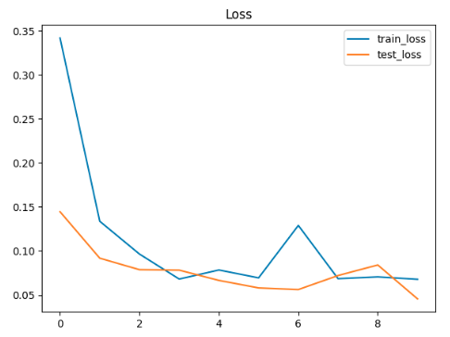
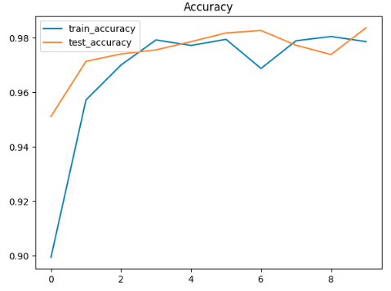
Create the training loop
for epoch in range(num_epochs):
for batch in train_dl:
train_step(model, optimizer, metrics, batch)
if step > 0 and (step % eval_every == 0 or step == train_steps - 1):
for metric, value in metrics.compute().items():
metrics_history[f'train_{metric}'].append(value)
metrics.reset() # Reset the metrics for the test set.
for test_batch in test_dl:
eval_step(model, metrics, test_batch)
Notes:
Now, we put everything together to create the main training loop. We iterate through the training dataset, and for each batch, we call the train_step function. At specified intervals, determined by the value of eval_every, or at the very end of the training, we compute and record the training metrics. We then run the eval_step on the test dataset, record the test metrics, and reset the metrics. This process continues for the specified number of training steps.

Slide 12
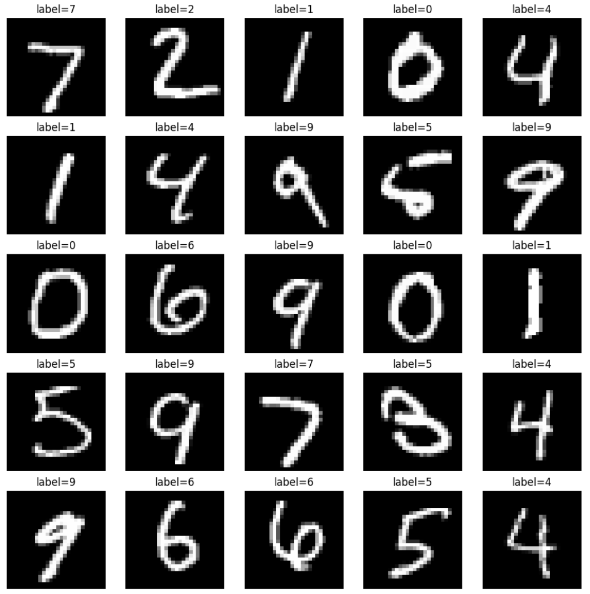
Run a few test images
model.eval() # Switch to evaluation mode.
@nnx.jit
def pred_step(model: CNN, batch):
logits = model(batch['image'])
return logits.argmax(axis=1)
test_batch = next(iter(test_dl))
pred = pred_step(model, test_batch)
fig, axs = plt.subplots(5, 5, figsize=(12, 12))
for i, ax in enumerate(axs.flatten()):
ax.imshow(test_batch['image'][i, ..., 0], cmap='gray')
ax.set_title(f'label={pred[i]}')
ax.axis('off')
Notes:
Finally, let's run our trained model on a few test images and visualize the predictions. First, we switch the model to evaluation mode using model.eval(). We then define a pred_step function to get the predicted labels. We take a batch from the test dataset and use pred_step to make predictions. Lastly, we plot a grid of test images with their corresponding predicted labels. This helps us visually assess how well the model is performing.

Slide 13

Learning Resources
Code Exercises, Quick References, and Slides
https://goo.gle/learning-jax
Notes:
You can learn more about JAX and the entire JAX AI Stack with these coding exercises, quick reference docs, and slides.

Slide 14
Community and Docs
Community:
https://goo.gle/jax-community
Docs
JAX AI Stack: https://jaxstack.ai
JAX: https://jax.dev
Flax NNX: https://flax.readthedocs.io
Notes:
There’s a growing community on Discord for JAX, here’s an invite link, and here are links to the docs for JAX, Flax, and the JAX AI Stack.

